Slide 1
CPE 133
Mixed Logic

Slide 2

EE Department Corporate Sponsor
www.bailbondsabc.com

Slide 3
Verilog Overview
Uses
Modeling digital circuits
Testing digital circuits
Stimulus driver/checker
Amazing Language
CPE 133 uses small basic subset
You must understand “the basics”
You know about 2/3 of “the basics” already

Slide 4
Generic Digital Circuit Model
Boxes exchanging information with boxes under the control of “something”
Nothing
Another box (internal)
An external signal (switch)
Another box (FSM or MCU)

Slide 5
Verilog Modeling
Boxes
Continuous assignment statements
Instantiations
Procedural blocks (always blocks)
Connections between boxes
Net data types
Wire (for continuous assignment statements)
Variable data types
Reg (for assignments in always blocks

Slide 6
Always blocks
Sensitivity list
List of signals the cause evaluation of block
Put all block inputs in sensitivity list
Statement group
Everything between the begin & end
Procedural programming statements
if-else, case
Procedural assignment statements
using of = sign

Slide 7
Mixed Logic
The full digital logic story has been hidden from you up to now
“No one really understands mixed logic”
Hardest thing to understand in digital design
You can get away without knowing it, but good digital designers know it

Slide 8
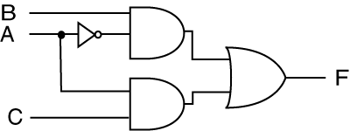

Different Circuits?

Slide 9

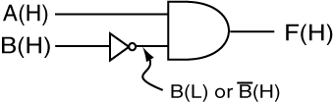
Mixed Logic
Based on which “state” causes an action
‘1’ action state: positive logic
‘0’ action state: negative logic
You’ve already worked with mixed logic

Slide 10
The Mixed Logic Problem
Implementing the “correct” functions in a mixed logic environment
Gates are stupid: the react to 1’s and 0’s without knowing about logic levels
The solution: understand logic functions at the basic level
Approach: match logic levels (bubble matching)

Slide 11


Mixed Logic Approach
Try not to use mixed logic…
But if you have to, you need to keep track of the logic levels
Use special indicators
Positive Logic Convention (PLC)
Direct Polarity Indicators (DPI)

Slide 12
Important Vernacular
“Asserted”
Not necessarily ‘1’ or ‘0’
Positive Logic
assertation level = high
asserted high
Active high
Negative logic
assertation level = low
asserted low
Active low
Is an asserted signal a ‘1’ or ‘0’?
it depends on logic type

Slide 13
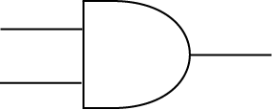
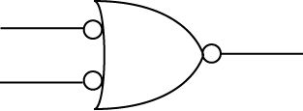
Approach
Equivalent signals
Equivalent gates

Slide 14
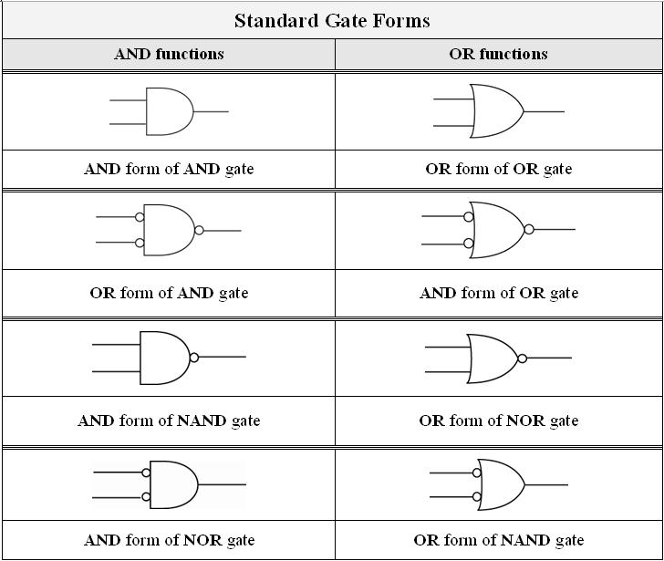
Equivalent Gates

Slide 15
Function Forms Revisited
Many different forms of functions
different forms use different gates
a few standard ones
Can be derived from SOP & POS form
Can be written in many ways…
If your gate is performing an AND function, draw the gate in an AND form
If your gate is performing an OR function, draw the gate in an OR form

Slide 16
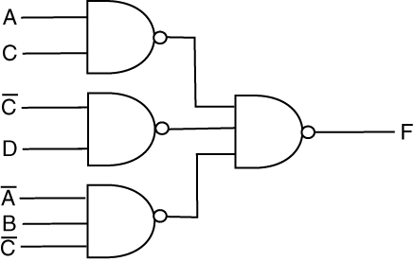
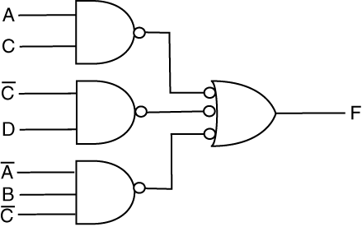
Good and Bad Implementations
Sad
Happy

Slide 17
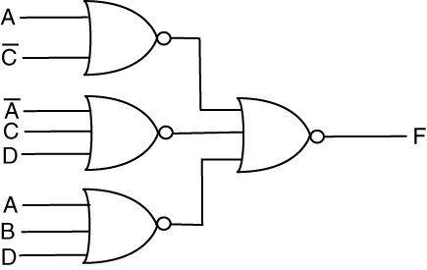
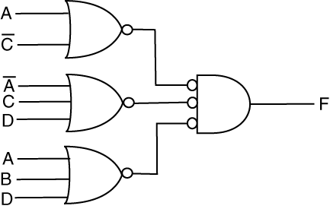
Good and Bad Implementations
Sad
Happy

Slide 18
The Approach To Mixed Logic
Analysis or Design
Use equivalent gates and equivalent signals where necessary in order to do what you need to do.

Slide 19

Mixed Logic Analysis Example
What function is being implemented if output is:
1) Active high
2) Active low

Slide 20

Mixed Logic Example
What function is being implemented if output is:
1) Active high
2) Active low

Slide 21
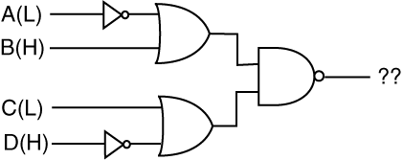
Mixed Logic Example
What function is being implemented if output is:
1) Active high
2) Active low

Slide 22
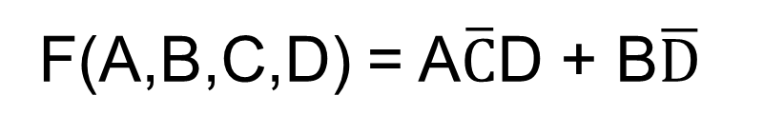
Mixed Logic Example
Design a circuit that implements the following function:
For this problem consider the A and B inputs and the output as asserted high; all other inputs are negative logic. Implement this function using any type of gates.
F(A,B,C,D) = A$\overline{C}$D + B$\overline{D}$

Slide 23
Experiment 7: Adder/Subtractor
5-bit Adder/Subtractor with validity detection
Inputs/Outputs are in RC format
Use foundation modules
Start with block diagram
Provided modules
8-bit RCA
sseg_dec.vhd
Simulate
Submit annotated timing diagram but note testbench VHDL file

